Slide 1
Outliers
Eric Kernfeld
HEART Choosing Statistical Methods

Slide 2
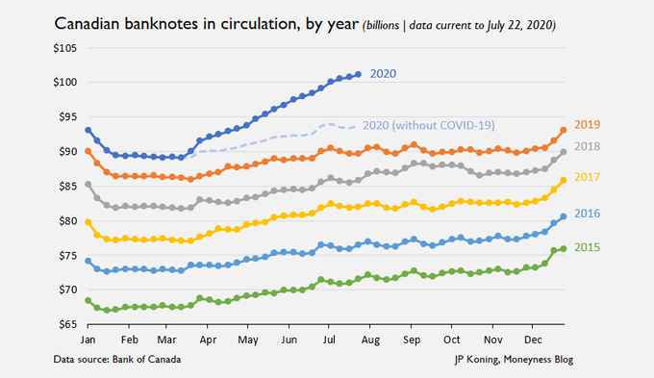
Monetary policy
J.P. Koning
https://jpkoning.blogspot.com/2020/07/how-pandemic-has-clogged-global-economy.html

Slide 3
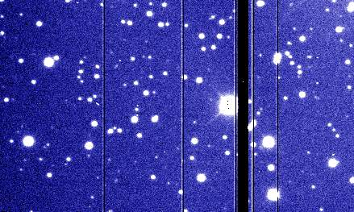
Radio astronomy
Olivier Hainaut
https://www.eso.org/~ohainaut/ccd/CCD_artifacts.html

Slide 4
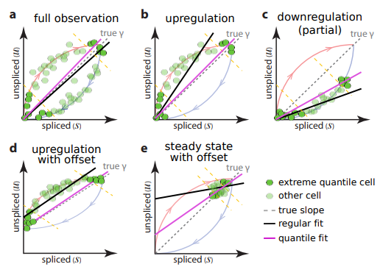
Kinetics of RNA splicing
La Manno et al. 2018
https://www.nature.com/articles/s41586-018-0414-6

Slide 5
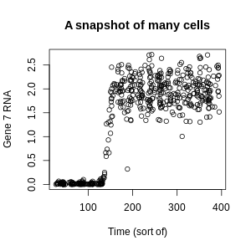
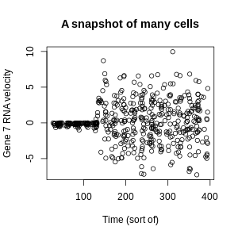
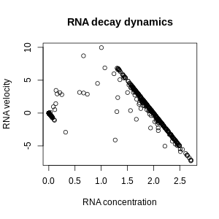
Simulated RNA levels
Made by me using BoolODE by Pratapa et al. https://murali-group.github.io/Beeline/BoolODE.html
https://www.nature.com/articles/s41592-019-0690-6

Slide 6
Outlier-tolerant statistical methods
Minimize J(m) = sum_{i} of (x_{i} - m)²:
Set sum_{i} of 2(x_{i} - m)=0
Set sum_{i} x_{i} = sum_{i} m, or in other words compute the mean
The penalty scales quadratically with distance. What if it scaled linearly or even less?

Slide 7
Outlier-tolerant statistical methods
Minimize J(m) = sum_{i} of |x_{i} - m|:
For two points: anything between them

Slide 8
Outlier-tolerant statistical methods
Minimize J(m) = sum_{i} of |x_{i} - m|:
For three points: the middle one

Slide 9
Outlier-tolerant statistical methods
Minimize J(m) = sum_{i} of |x_{i} - m|:
For four points: anything between the middle two

Slide 10
Outlier-tolerant statistical methods
Minimize J(m) = sum_{i} of |x_{i} - m|:
For n points: the sample median

Slide 11
Outlier-tolerant statistical methods
Ordinary least squares: minimize sum_{i} (Y_{i} - bX_{i})²
Quantile regression: minimize sum_{i} |Y_{i} - bX_{i}|

